Slide 1

ANTIINFLAMMATORY THERAPY AND INFLAMMATION IN PULMONARY INFECTIONS
Francesco Blasi
Department Pathophysiology and Transplantation,
University of Milan, Italy

Slide 2
Disclosures
I have accepted grants, speaking and conference invitations from Almirall, Angelini, AstraZeneca, Bayer, Chiesi, GSK, Guidotti-Malesci, Menarini, Novartis, Pfizer, and Zambon
I have had recent or ongoing consultancy with Almirall, Angelini, AstraZeneca, GSK, Menarini, Mundipharma and Novartis

Slide 3
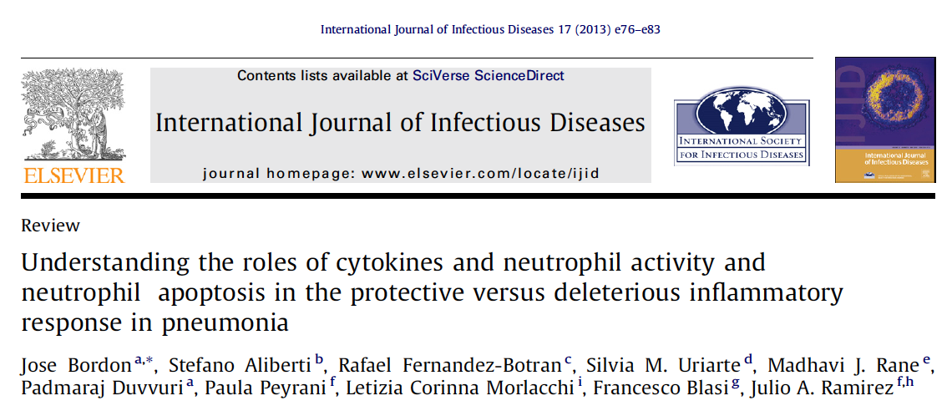

Slide 4
Inflammation is a double-edged sword in the outcome of pneumonia.
On the one hand, an effective and timely inflammatory response is required to eliminate the invading respiratory pathogen.
On the other, a toxic and prolonged inflammatory response may result in lung injury and poor outcomes, even in those receiving advanced medical care

Slide 5
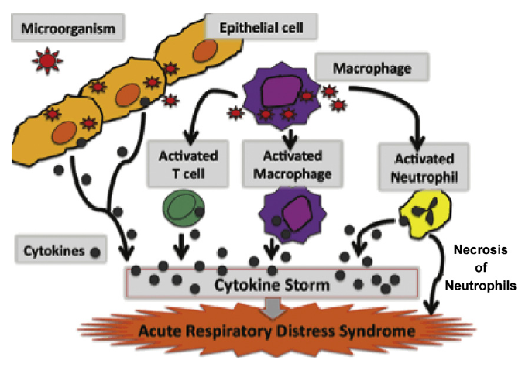

Slide 6
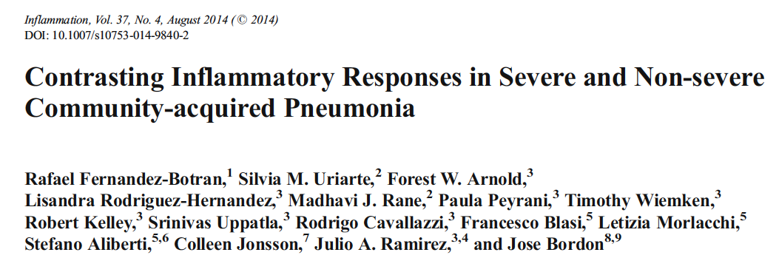

Slide 7
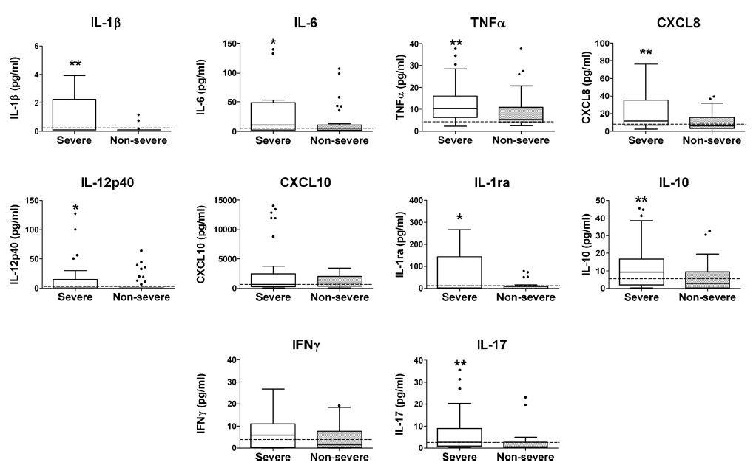
Plasma cytokine profiles in non-severe and severe CAP patient groups.
Blood samples were obtained shortly after admission

Slide 8
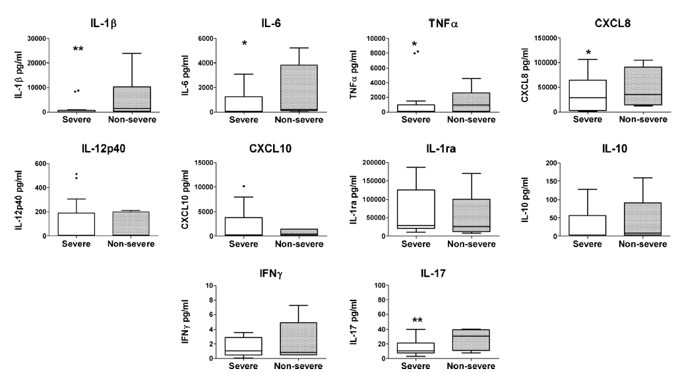
Sputum cytokine profiles in non-severe and severe CAP patient groups.
Blood samples were obtained shortly after admission

Slide 9
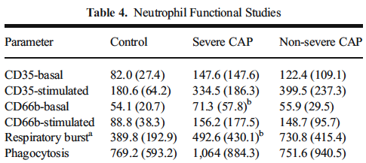

Slide 10
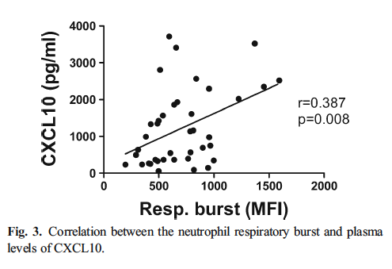
A reduced production of CXCL10 correlates with decreased ability to attract T lymphocytes, particularly the Th1 subset, to the lungs, therefore further
compromising the ability to adequately control infection

Slide 11
At the time of hospital admission, patients with severe CAP have a decreased local inflammatory response and an exaggerated systemic inflammatory response when compared to patients with non-severe CAP.
This observation suggests that patients with severe CAP may have a lower and suboptimal lung inflammatory response resulting in an inability to control the microbial invasion at the local level.

Slide 12
Despite the activated status of neutrophils in hospitalized patients with CAP compared to healthy controls, neutrophils in patients with severe CAP showed moderately but significantly reduced levels of respiratory burst activity when compared to patients with non-severe CAP.
This is consistent with reduced bactericidal capacity and an inability to control bacterial infection

Slide 13
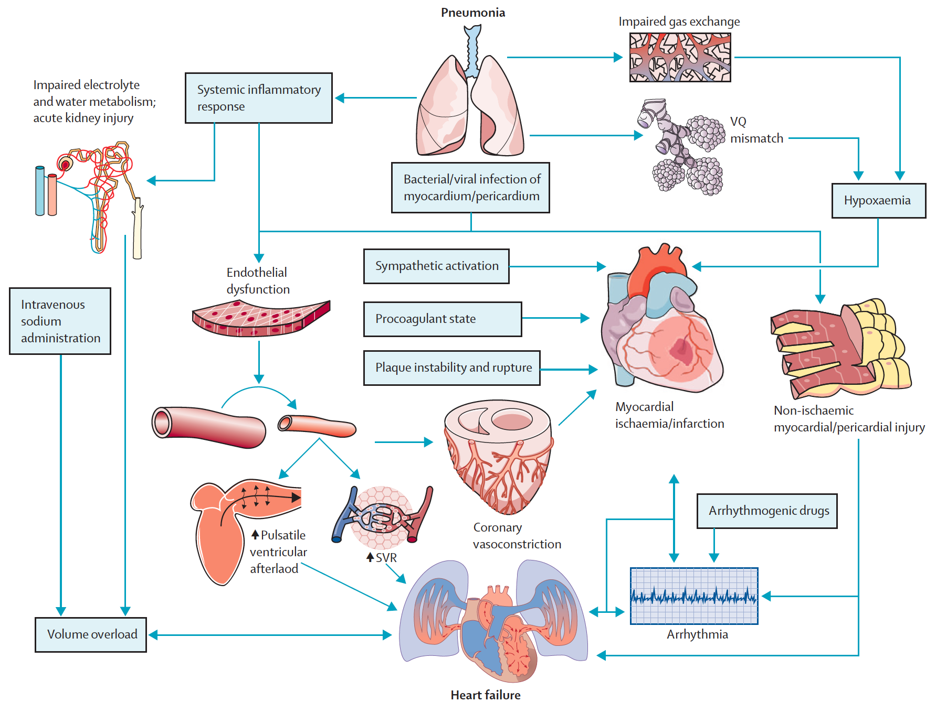
Pneumonia and Cardiovascular events PATHOPHYSIOLOGICAL MECHANISMS
Corrales-Medina. Lancet 2012
Notes:
Proposed pathophysiological mechanisms contributing to cardiac complications in patients with acute pneumonia

Slide 14
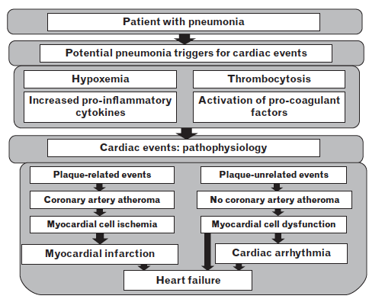

Slide 15

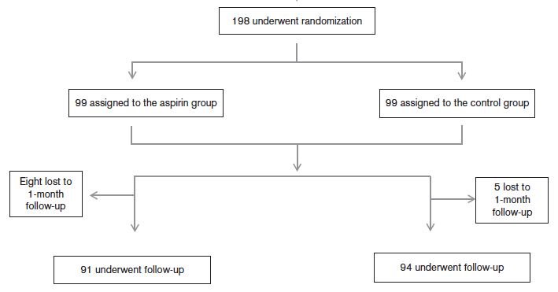
From epidemiology to intervention
300mg of aspirin daily for 1 month.
Notes:
Objectives The aim of this study was to test the
hypothesis that aspirin would reduce the risk for acute
coronary syndromes (ACSs) in patients with pneumonia.
Backgrounds Pooled data suggest that pneumonia may
trigger an ACS as a result of inflammatory reactions and
the prothrombotic changes in patients with pneumonia.
Hypothetically considering its antiaggregating and antiinflammatory
effects, aspirin might also be beneficial for
the primary prevention of ACS in patients with pneumonia.
Methods One hundred and eighty-five patients with
pneumonia who had more than one risk factor for
cardiovascular disease were randomized to an aspirin
group (n= 91) or a control group (n =94). The patients in
the aspirin group received 300mg of aspirin daily for 1
month. ECGs were recorded on admission and 48 h and 30
days after admission to assess silent ischemia. The level of
high-sensitivity cardiac troponin T was measured on
admission and 48 h after admission. The primary endpoint
was the development of ACS within 1 month. The
secondary endpoints included cardiovascular death and
death from any cause within 1 month.
Results The v2-test showed that the rates of ACS at 1
month were 1.1% (n = 1) in the aspirin group and 10.6%
(n= 10) in the control group (relative risk, 0.103; 95%
confidence interval 0.005–0.746; P = 0.015). Aspirin therapy
was associated with a 9% absolute reduction in the risk forACS. There was no significant decrease in the risk of death
from any cause (P =0.151), but the aspirin group had a
decreased risk of cardiovascular death (risk reduction:
0.04, P = 0.044).
Conclusion This randomized open-label study shows that
acetyl salicylic acid is beneficial in the reduction of ACS
and cardiovascular mortality among patients with
pneumonia.

Slide 16
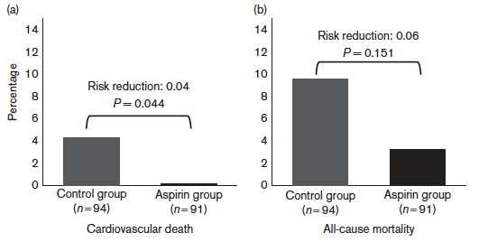
From epidemiology to intervention
Notes:
Objectives The aim of this study was to test the
hypothesis that aspirin would reduce the risk for acute
coronary syndromes (ACSs) in patients with pneumonia.
Backgrounds Pooled data suggest that pneumonia may
trigger an ACS as a result of inflammatory reactions and
the prothrombotic changes in patients with pneumonia.
Hypothetically considering its antiaggregating and antiinflammatory
effects, aspirin might also be beneficial for
the primary prevention of ACS in patients with pneumonia.
Methods One hundred and eighty-five patients with
pneumonia who had more than one risk factor for
cardiovascular disease were randomized to an aspirin
group (n= 91) or a control group (n =94). The patients in
the aspirin group received 300mg of aspirin daily for 1
month. ECGs were recorded on admission and 48 h and 30
days after admission to assess silent ischemia. The level of
high-sensitivity cardiac troponin T was measured on
admission and 48 h after admission. The primary endpoint
was the development of ACS within 1 month. The
secondary endpoints included cardiovascular death and
death from any cause within 1 month.
Results The v2-test showed that the rates of ACS at 1
month were 1.1% (n = 1) in the aspirin group and 10.6%
(n= 10) in the control group (relative risk, 0.103; 95%
confidence interval 0.005–0.746; P = 0.015). Aspirin therapy
was associated with a 9% absolute reduction in the risk forACS. There was no significant decrease in the risk of death
from any cause (P =0.151), but the aspirin group had a
decreased risk of cardiovascular death (risk reduction:
0.04, P = 0.044).
Conclusion This randomized open-label study shows that
acetyl salicylic acid is beneficial in the reduction of ACS
and cardiovascular mortality among patients with
pneumonia.

Slide 17
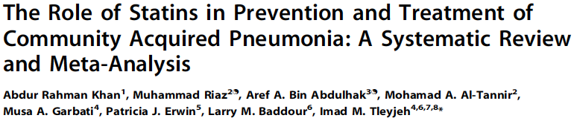
From epidemiology to intervention
Notes:
Emerging epidemiological evidence suggests that statins may reduce the risk of community-acquired
pneumonia (CAP) and its complications.
Purpose: Performed a systematic review to address the role of statins in the prevention or treatment of CAP.
Data Source: Ovid MEDLINE, Cochrane, EMBASE, ISI Web of Science, and Scopus from inception through December 2011
were searched for randomized clinical trials, cohort and case-control studies.
Study Selection: Two authors independently reviewed studies that examined the role of statins in CAP.
Data Extraction: Data about study characteristics, adjusted effect-estimates and quality characteristics was extracted.
Data Synthesis: Eighteen studies corresponding to 21 effect-estimates (eight and 13 of which addressed the preventive and
therapeutic roles of statins, respectively) were included. All studies were of good methodological quality. Random-effects
meta-analyses of adjusted effect-estimates were used. Statins were associated with a lower risk of CAP, 0.84 (95% CI, 0.74–
0.95), I2 = 90.5% and a lower short-term mortality in patients with CAP, 0.68 (95% CI, 0.59–0.78), I2 = 75.7%. Meta-regression
did not identify sources of heterogeneity. A funnel plot suggested publication bias in the treatment group, which was
adjusted by a novel regression method with a resultant effect-estimate of 0.85 (95% CI, 0.77–0.93). Sensitivity analyses using
the rule-out approach showed that it is unlikely that the results were due to an unmeasured confounder.
Conclusions: Our meta-analysis reveals a beneficial role of statins for the risk of development and mortality associated with
CAP. However, the results constitute very low quality evidence as per the GRADE framework due to observational study
design, heterogeneity and publication bias

Slide 18
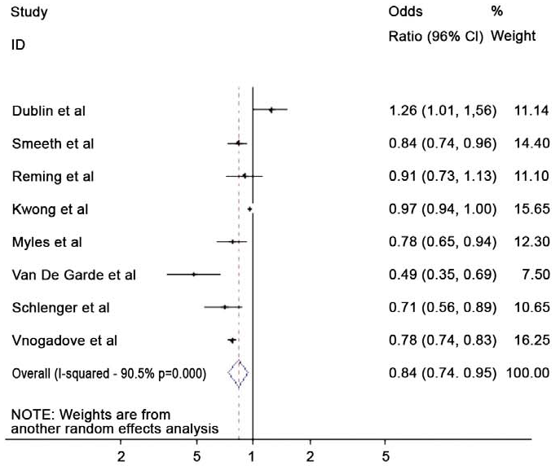
From epidemiology to intervention
Protective effect of statins against the development of CAP
Notes:
Emerging epidemiological evidence suggests that statins may reduce the risk of community-acquired
pneumonia (CAP) and its complications.
Purpose: Performed a systematic review to address the role of statins in the prevention or treatment of CAP.
Data Source: Ovid MEDLINE, Cochrane, EMBASE, ISI Web of Science, and Scopus from inception through December 2011
were searched for randomized clinical trials, cohort and case-control studies.
Study Selection: Two authors independently reviewed studies that examined the role of statins in CAP.
Data Extraction: Data about study characteristics, adjusted effect-estimates and quality characteristics was extracted.
Data Synthesis: Eighteen studies corresponding to 21 effect-estimates (eight and 13 of which addressed the preventive and
therapeutic roles of statins, respectively) were included. All studies were of good methodological quality. Random-effects
meta-analyses of adjusted effect-estimates were used. Statins were associated with a lower risk of CAP, 0.84 (95% CI, 0.74–
0.95), I2 = 90.5% and a lower short-term mortality in patients with CAP, 0.68 (95% CI, 0.59–0.78), I2 = 75.7%. Meta-regression
did not identify sources of heterogeneity. A funnel plot suggested publication bias in the treatment group, which was
adjusted by a novel regression method with a resultant effect-estimate of 0.85 (95% CI, 0.77–0.93). Sensitivity analyses using
the rule-out approach showed that it is unlikely that the results were due to an unmeasured confounder.
Conclusions: Our meta-analysis reveals a beneficial role of statins for the risk of development and mortality associated with
CAP. However, the results constitute very low quality evidence as per the GRADE framework due to observational study
design, heterogeneity and publication bias

Slide 19
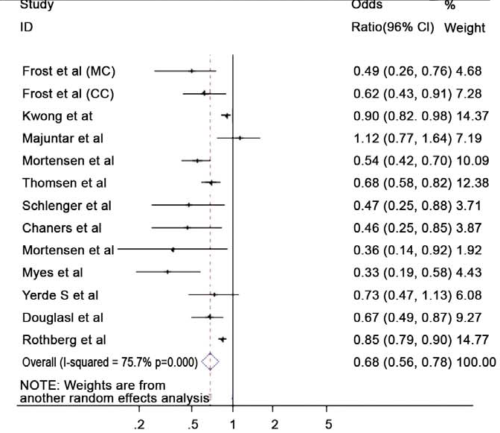
From epidemiology to intervention
Protective effect of statins against the development of CAP
Statin use was significantly associated with reduced mortality in patients
with CAP.
Notes:
Emerging epidemiological evidence suggests that statins may reduce the risk of community-acquired
pneumonia (CAP) and its complications.
Purpose: Performed a systematic review to address the role of statins in the prevention or treatment of CAP.
Data Source: Ovid MEDLINE, Cochrane, EMBASE, ISI Web of Science, and Scopus from inception through December 2011
were searched for randomized clinical trials, cohort and case-control studies.
Study Selection: Two authors independently reviewed studies that examined the role of statins in CAP.
Data Extraction: Data about study characteristics, adjusted effect-estimates and quality characteristics was extracted.
Data Synthesis: Eighteen studies corresponding to 21 effect-estimates (eight and 13 of which addressed the preventive and
therapeutic roles of statins, respectively) were included. All studies were of good methodological quality. Random-effects
meta-analyses of adjusted effect-estimates were used. Statins were associated with a lower risk of CAP, 0.84 (95% CI, 0.74–
0.95), I2 = 90.5% and a lower short-term mortality in patients with CAP, 0.68 (95% CI, 0.59–0.78), I2 = 75.7%. Meta-regression
did not identify sources of heterogeneity. A funnel plot suggested publication bias in the treatment group, which was
adjusted by a novel regression method with a resultant effect-estimate of 0.85 (95% CI, 0.77–0.93). Sensitivity analyses using
the rule-out approach showed that it is unlikely that the results were due to an unmeasured confounder.
Conclusions: Our meta-analysis reveals a beneficial role of statins for the risk of development and mortality associated with
CAP. However, the results constitute very low quality evidence as per the GRADE framework due to observational study
design, heterogeneity and publication bias

Slide 20
From epidemiology to intervention
Protective effect of statins against the development of CAP
Statin use was significantly associated with reduced mortality in patients
with CAP.
Low quality evidence
Notes:
Emerging epidemiological evidence suggests that statins may reduce the risk of community-acquired
pneumonia (CAP) and its complications.
Purpose: Performed a systematic review to address the role of statins in the prevention or treatment of CAP.
Data Source: Ovid MEDLINE, Cochrane, EMBASE, ISI Web of Science, and Scopus from inception through December 2011
were searched for randomized clinical trials, cohort and case-control studies.
Study Selection: Two authors independently reviewed studies that examined the role of statins in CAP.
Data Extraction: Data about study characteristics, adjusted effect-estimates and quality characteristics was extracted.
Data Synthesis: Eighteen studies corresponding to 21 effect-estimates (eight and 13 of which addressed the preventive and
therapeutic roles of statins, respectively) were included. All studies were of good methodological quality. Random-effects
meta-analyses of adjusted effect-estimates were used. Statins were associated with a lower risk of CAP, 0.84 (95% CI, 0.74–
0.95), I2 = 90.5% and a lower short-term mortality in patients with CAP, 0.68 (95% CI, 0.59–0.78), I2 = 75.7%. Meta-regression
did not identify sources of heterogeneity. A funnel plot suggested publication bias in the treatment group, which was
adjusted by a novel regression method with a resultant effect-estimate of 0.85 (95% CI, 0.77–0.93). Sensitivity analyses using
the rule-out approach showed that it is unlikely that the results were due to an unmeasured confounder.
Conclusions: Our meta-analysis reveals a beneficial role of statins for the risk of development and mortality associated with
CAP. However, the results constitute very low quality evidence as per the GRADE framework due to observational study
design, heterogeneity and publication bias

Slide 21
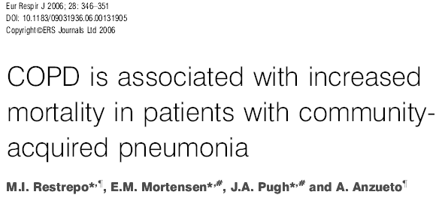
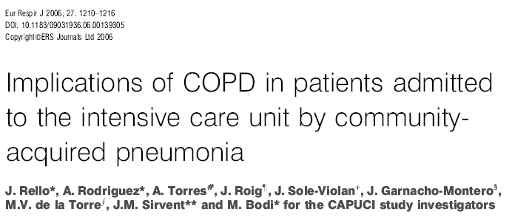
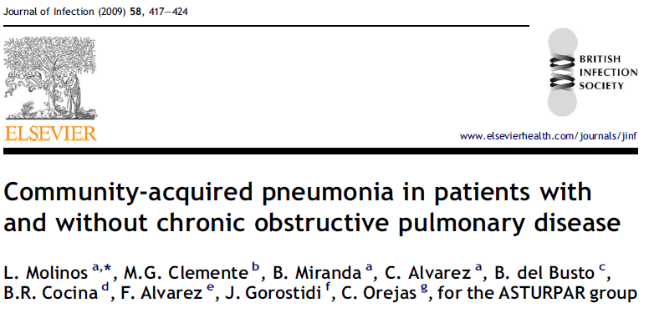
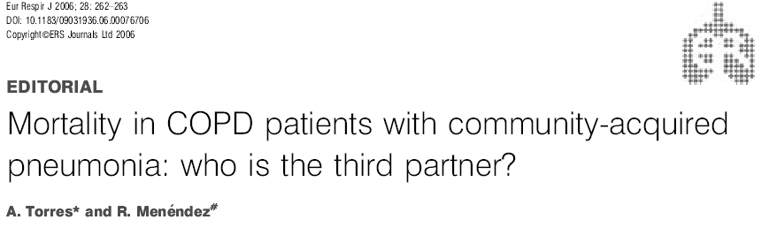
Steroids?
Down regulation of inflammation or local immune response in colonized patients?

Slide 22
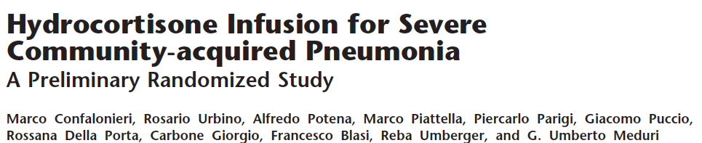
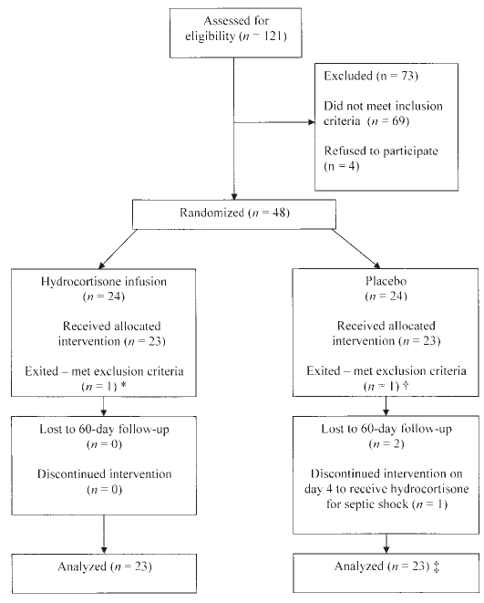

Slide 23
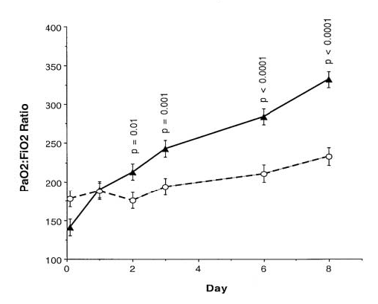
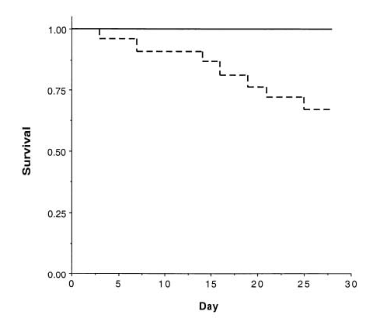

Slide 24
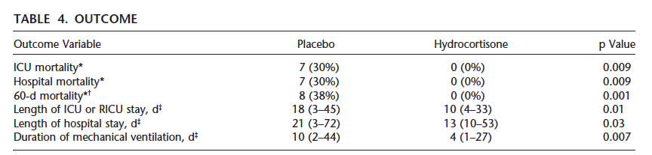
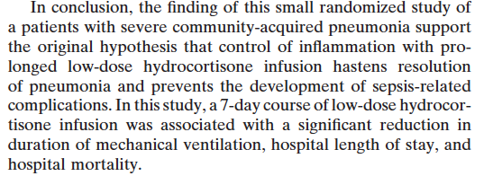

Slide 25
CONCLUSIONS
It can be hypothesized that, patients who are able to produce an adequate local pulmonary response are able to contain the microorganisms, do not develop an exaggerated systemic response, and present with a non-severe CAP
The therapeutic management of inflammation in patients with severe CAP should be PROBABLY different for the lung and for the systemic circulation

Slide 26

THANK YOU FOR YOUR ATTENTION !

