Slide 1
Clinical Outcomes in Patients with
Community-Acquired Pneumonia
Julio A. Ramirez, MD, FACP
Professor of Medicine
Chief, Infectious Diseases University of Louisville
Chief, Infectious Diseases Veterans Affairs Medical Center
Louisville, Kentucky, USA

Slide 2
CAP Clinical Outcomes
1. CAP Pathogenesis
2. CAP Early Clinical Outcomes
3. CAP Late Clinical Outcomes

Slide 3
Pneumonia Pathogenesis
Pneumonia
Alveolar
Macrophage
White Blood
Cell
Capillary
Lymphatic
Ramirez J. Community-Acquired Pneumonia. Lippincott Williams & Wilkins, 2003

Slide 4
Pneumonia Pathogenesis
Pneumonia
Alveolar
Macrophage
White Blood
Cell
Capillary
Lymphatic
Ramirez J. Community-Acquired Pneumonia. Lippincott Williams & Wilkins, 2003

Slide 5
Pneumonia Pathogenesis
Pneumonia
Generation of Cytokines
Alveolar
Macrophage
White Blood
Cell
Cytokines
Capillary
Lymphatic
Ramirez J. Community-Acquired Pneumonia. Lippincott Williams & Wilkins, 2003

Slide 6
Pneumonia Pathogenesis
Pneumonia
Generation of Cytokines
Alveolar
Macrophage
Proinflammatory Cytokines
IL-1 IL-1β IL-6 TNF-α G-CSF IFN-γ
White Blood
Cell
White Blood
Cell
Chemotactic Cytokines (Chemokines)
Cytokines
CCL2 CCL3 CCL4 CCL5 CXCL1 (KC) CXCL10 (IP-10)
Cytokines
Cytokines
Anti-inflammatory Cytokines
Interleukin-10 (IL-10)
IL-1 receptor antagonist (IL-1ra)
Capillary
Lymphatic
Lymphatic
Ramirez J. Community-Acquired Pneumonia. Lippincott Williams & Wilkins, 2003

Slide 7
Pneumonia Pathogenesis
Pneumonia
Activation of Neutrophils
Alveolar
Macrophage
Local Inflammatory Response
White Blood
Cell
Capillary
Lymphatic
Ramirez J. Community-Acquired Pneumonia. Lippincott Williams & Wilkins, 2003

Slide 8
Pneumonia Pathogenesis
Pneumonia
Neutrophils
Consolidation Phase
Monocytes
Alveolar
Macrophage
B / T cells
Dendritic cells
Fluid/Proteins
White Blood
Cell
Cytokines
Capillary
Lymphatic
Ramirez J. Community-Acquired Pneumonia. Lippincott Williams & Wilkins, 2003

Slide 9
Pneumonia Pathogenesis
Pneumonia
Neutrophils
Consolidation Phase
Monocytes
Alveolar
Macrophage
B / T cells
Dendritic cells
Local Inflammatory Response
Fluid/Proteins
White Blood
Cell
Systemic Inflammatory Response
Cytokines
Capillary
Lymphatic
Ramirez J. Community-Acquired Pneumonia. Lippincott Williams & Wilkins, 2003

Slide 10
Pneumonia Pathogenesis
Diagnosis
Local Inflammatory Response
A
Severity of Disease
Systemic Inflammatory Response
0 1 2 3 4 5 6 7
Days
ATS Guidelines for CAP. Am J Respir Crit Care Med 163:1730, 2001

Slide 11
Pneumonia Pathogenesis
Diagnosis
v
Cough
Sputum
Tachypnea
Hypoxemia
Infiltrate
Local Inflammatory Response
A
Severity of Disease
Fever
Leukocytosis
CRP
ESR
Procalcitonin
Systemic Inflammatory Response
0 1 2 3 4 5 6 7
Days
ATS Guidelines for CAP. Am J Respir Crit Care Med 163:1730, 2001

Slide 12
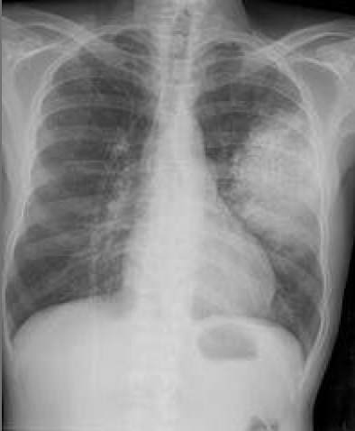
Pneumonia Pathogenesis
Diagnosis
v
Cough
Sputum
Tachypnea
Hypoxemia
Infiltrate
Local Inflammatory Response
A
Severity of Disease
Fever
Leukocytosis
CRP
ESR
Procalcitonin
Systemic Inflammatory Response
0 1 2 3 4 5 6 7
Days
ATS Guidelines for CAP. Am J Respir Crit Care Med 163:1730, 2001

Slide 13
CAP Clinical Outcomes
1. CAP Pathogenesis
2. CAP Early Clinical Outcomes
3. CAP Late Clinical Outcomes

Slide 14
CAP: Clinical Outcomes
A
Severity of Disease
0 1 2 3 4 5 6 7
Days

Slide 15
CAP: Clinical Outcomes
Clinical
Response
to Therapy
A
Severity of Disease
0 1 2 3 4 5 6 7
Days
ATS Guidelines for CAP. Am J Respir Crit Care Med 163:1730, 2001

Slide 16
CAP: Clinical Outcomes
A
B
Severity of Disease
Early
Clinical
Improvement
Late
Clinical
Improvement
1
2
0 1 2 3 4 5 6 7
Days
ATS Guidelines for CAP. Am J Respir Crit Care Med 163:1730, 2001

Slide 17
CAP: Clinical Outcomes
Early
Clinical
Deterioration
Late
Clinical
Deterioration
3
4
A
B
Severity of Disease
Early
Clinical
Improvement
Late
Clinical
Improvement
1
2
0 1 2 3 4 5 6 7
Days
ATS Guidelines for CAP. Am J Respir Crit Care Med 163:1730, 2001

Slide 18
CAP: Clinical Outcomes
Early
Clinical
Deterioration
Late
Clinical
Deterioration
3
4
Nonresponding
Pneumonia
A
B
5
Severity of Disease
Early
Clinical
Improvement
Late
Clinical
Improvement
1
2
0 1 2 3 4 5 6 7
Days
ATS Guidelines for CAP. Am J Respir Crit Care Med 163:1730, 2001

Slide 19
CAP: Clinical Outcomes
Early
Clinical
Deterioration
Late
Clinical
Deterioration
3
4
Nonresponding
Pneumonia
A
B
5
Severity of Disease
Early
Clinical
Improvement
Late
Clinical
Improvement
1
2
0 1 2 3 4 5 6 7
Days

Slide 20
CAP: Clinical Outcomes
CAP: clinical, radiographic, immunologic, & microbiologic responses
Point of Clinical Stability
Severity
of Disease
Clinical
Response
Days

Slide 21
CAP: Clinical Outcomes
CAP: clinical, radiographic, immunologic, & microbiologic responses
Pulmonary
Infiltrate
Severity
of Disease
X-ray
Resolution
Clinical
Response
Days

Slide 22
CAP: Clinical Outcomes
CAP: clinical, radiographic, immunologic, & microbiologic responses
Pulmonary
Infiltrate
Severity
of Disease
Inflammatory
Markers
X-ray
Resolution
Immune
Response
Clinical
Response
Days

Slide 23
CAP: Clinical Outcomes
CAP: clinical, radiographic, immunologic, & microbiologic responses
Pulmonary
Infiltrate
Severity
of Disease
Inflammatory
Markers
X-ray
Resolution
Bacterial
Colony
Counts
Micro
Response
Immune
Response
Clinical
Response
Days

Slide 24
CAP: Clinical Outcomes
CAP: clinical, radiographic, immunologic, & microbiologic responses
Pulmonary
Infiltrate
Point of Clinical Stability
Point of Switch Therapy
Severity
of Disease
Inflammatory
Markers
X-ray
Resolution
Bacterial
Colony
Counts
Micro
Response
Immune
Response
Clinical
Response
Time to Clinical Stability
Days
Time to Switch Therapy

Slide 25
CAP: Clinical Outcomes
Early
Clinical
Deterioration
Late
Clinical
Deterioration
3
4
Nonresponding
Pneumonia
A
B
5
Severity of Disease
Early
Clinical
Improvement
Late
Clinical
Improvement
1
2
0 1 2 3 4 5 6 7
Days

Slide 26

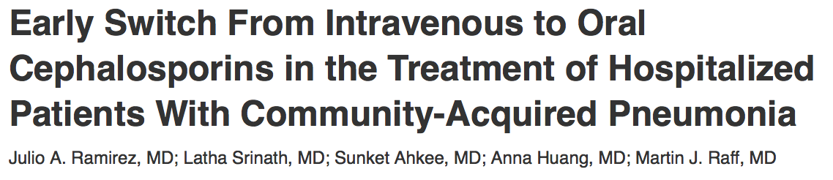

CAP: Clinical Outcomes
Early
Clinical
Deterioration
Late
Clinical
Deterioration
3
4
Nonresponding
Pneumonia
A
B
5
Severity of Disease
Early
Clinical
Improvement
Late
Clinical
Improvement
1
2
0 1 2 3 4 5 6 7
Days

Slide 27
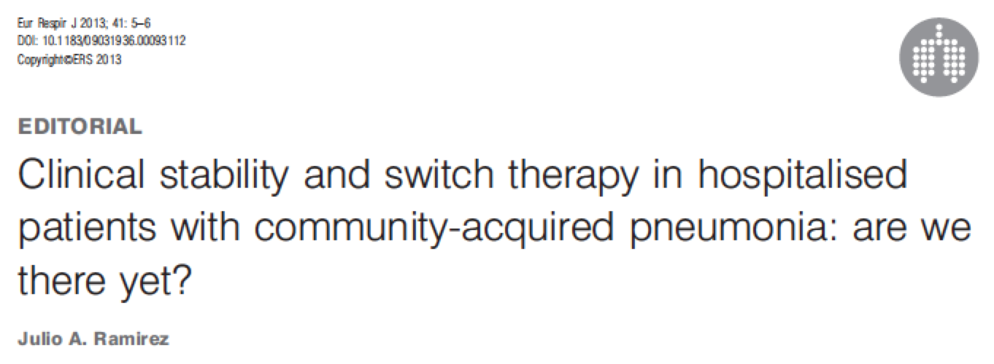
CAP: Clinical Outcomes
Early
Clinical
Deterioration
Late
Clinical
Deterioration
3
4
Nonresponding
Pneumonia
A
B
5
Severity of Disease
Early
Clinical
Improvement
Late
Clinical
Improvement
1
2
0 1 2 3 4 5 6 7
Days

Slide 28
Clinical Outcomes
Early
Clinical
Deterioration
Late
Clinical
Deterioration
3
4
Nonresponding
Pneumonia
A
B
5
Severity of Disease
Early
Clinical
Improvement
Late
Clinical
Improvement
1
2
0 1 2 3 4 5 6 7
Days

Slide 29
Clinical Outcomes
Early
Clinical
Deterioration
Late
Clinical
Deterioration
Severe
CAP
3
4
Nonresponding
Pneumonia
CAP
A
B
5
Severity of Disease
Early
Clinical
Improvement
Late
Clinical
Improvement
1
2
0 1 2 3 4 5 6 7
Days

Slide 30
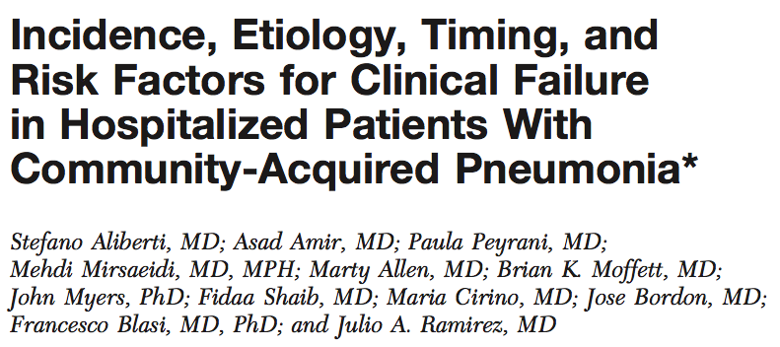
Clinical Outcomes
Early
Clinical
Deterioration
Late
Clinical
Deterioration
3
4
Nonresponding
Pneumonia
A
B
5
Severity of Disease
Early
Clinical
Improvement
Late
Clinical
Improvement
1
2
0 1 2 3 4 5 6 7
Days
Aliberti S et al. Chest. 2008;134:955-962

Slide 31
Clinical Outcomes
Early
Clinical
Deterioration
Late
Clinical
Deterioration
4
Etiology of
Failure
3
1. Severe
Sepsis
(33%)
Nonresponding
Pneumonia
A
B
5
Severity of Disease
Early
Clinical
Improvement
Late
Clinical
Improvement
1
2
0 1 2 3 4 5 6 7
Days
Aliberti S et al. Chest. 2008;134:955-962

Slide 32
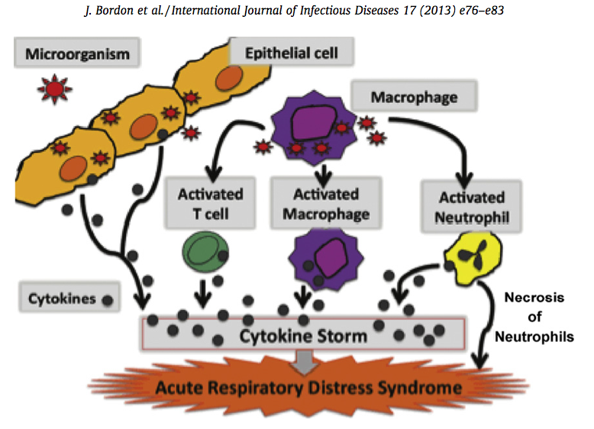
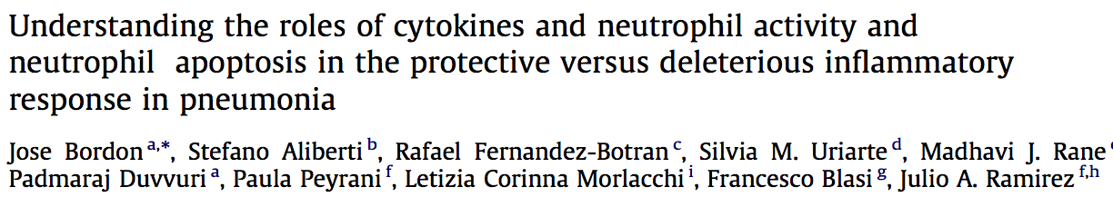
Clinical Outcomes
Early
Clinical
Deterioration
Late
Clinical
Deterioration
Late
Clinical
Deterioration
3
4
4
Etiology of
Failure
3
1. Severe
Sepsis
(33%)
Nonresponding
Pneumonia
A
B
B
5
5
Severity of Disease
Early
Clinical
Improvement
Late
Clinical
Improvement
Late
Clinical
Improvement
1
1
2
2
0 1 2 3 4 5 6 7
Days
Days

Slide 33
Clinical Outcomes
LIR
Local
Infection

Slide 34
Clinical Outcomes
LIR
SIRS
Local
Infection
CAP

Slide 35
Clinical Outcomes
LIR
SIRS
Organ Dysfunction/Failure
MODS
Local
Infection
CAP
Severe
CAP

Slide 36
Clinical Outcomes
LIR
SIRS
Organ Dysfunction/Failure
MODS
Respiratory
RR>30, PO2<60, PA/FI<250, ARDS, MV
Cardiovascular
↑HR, BP<90/60, Refractory Shock
Renal
↓Urinary output, ↑BUN, ↑Creatinine
Local
Infection
Sepsis
Severe
Sepsis
CNS
Mental status changes, Abnormal EEG
Hematology
Neutropenia, ↓Hb, Platelets<100K, DIC
Metabolism
↑Glucose, ↓Temperature, ↓Ph, ↑Lactate,
Mortality rates increase in patients >65yo (↓immunologic response to infection)

Slide 37
Clinical Outcomes
LIR
SIRS
Organ Dysfunction/Failure
MODS
Respiratory
RR>30, PO2<60, PA/FI<250, ARDS, MV
Cardiovascular
↑HR, BP<90/60, Refractory Shock
Renal
↓Urinary output, ↑BUN, ↑Creatinine
Local
Infection
CAP
Severe
CAP
CNS
Mental status changes, Abnormal EEG
Hematology
Neutropenia, ↓Hb, Platelets<100K, DIC
Metabolism
↑Glucose, ↓Temperature, ↓Ph, ↑Lactate,
Mortality rates increase in patients >65yo (↓immunologic response to infection)

Slide 38
Clinical Outcomes
LIR
SIRS
Organ Dysfunction/Failure
MODS
Respiratory
RR>30, PO2<60, PA/FI<250, ARDS, MV
CURB-65
Cardiovascular
↑HR, BP<90/60, Refractory Shock
Renal
↓Urinary output, ↑BUN, ↑Creatinine
Local
Infection
CAP
Severe
CAP
CNS
Mental status changes, Abnormal EEG
Hematology
Neutropenia, ↓Hb, Platelets<100K, DIC
PSI
Metabolism
↑Glucose, ↓Temperature, ↓Ph, ↑Lactate,
Mortality rates increase in patients >65yo (↓immunologic response to infection)

Slide 39
Clinical Outcomes
LIR
SIRS
Organ Dysfunction/Failure
MODS
Respiratory
RR>30, PO2<60, PA/FI<250, ARDS, MV
CURB-65
Cardiovascular
↑HR, BP<90/60, Refractory Shock
Renal
↓Urinary output, ↑BUN, ↑Creatinine
Local
Infection
CAP
Severe
CAP
CNS
Mental status changes, Abnormal EEG
Hematology
Neutropenia, ↓Hb, Platelets<100K, DIC
PSI
Metabolism
↑Glucose, ↓Temperature, ↓Ph, ↑Lactate,
Mortality rates increase in patients >65yo (↓immunologic response to infection)

Slide 40
Clinical Outcomes
LIR
SIRS
Organ Dysfunction/Failure
MODS
Respiratory
RR>30, PO2<60, PA/FI<250, ARDS, MV
CURB-65
Cardiovascular
↑HR, BP<90/60, Refractory Shock
Renal
↓Urinary output, ↑BUN, ↑Creatinine
Local
Infection
CAP
Severe
CAP
CNS
Mental status changes, Abnormal EEG
Hematology
Neutropenia, ↓Hb, Platelets<100K, DIC
PSI
Metabolism
↑Glucose, ↓Temperature, ↓Ph, ↑Lactate,
Mortality rates increase in patients >65yo (↓immunologic response to infection)

Slide 41
Clinical Outcomes
Clinical Failure:
Severe
Sepsis
30%
Early
Clinical
Deterioration
Late
Clinical
Deterioration
3
4
Nonresponding
Pneumonia
A
B
5
Severity of Disease
Early
Clinical
Improvement
Late
Clinical
Improvement
1
2
0 1 2 3 4 5 6 7
Days

Slide 42
Clinical Outcomes
Early
Clinical
Deterioration
Late
Clinical
Deterioration
Clinical
Failure:
AMI
20%
3
4
Nonresponding
Pneumonia
A
B
5
Severity of Disease
Early
Clinical
Improvement
Late
Clinical
Improvement
1
2
0 1 2 3 4 5 6 7
Days

Slide 43
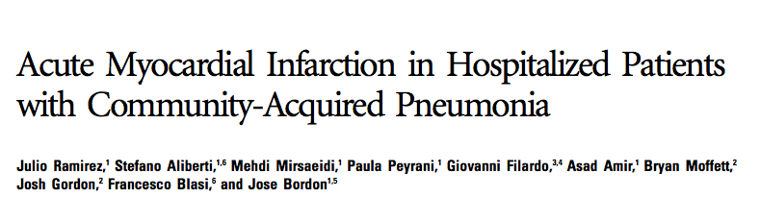
Clinical Outcomes
Early
Clinical
Deterioration
Late
Clinical
Deterioration
Clinical
Failure:
AMI
20%
3
4
Nonresponding
Pneumonia
A
B
5
Severity of Disease
Early
Clinical
Improvement
Late
Clinical
Improvement
1
2
0 1 2 3 4 5 6 7
Days
Ramirez J et al. Clin Infec Dises. 2008;47:182-7

Slide 44
Clinical Outcomes
Early
Clinical
Deterioration
Late
Clinical
Deterioration
Clinical
Failure:
AMI
20%
3
4
Nonresponding
Pneumonia
A
B
5
Severity of Disease
Early
Clinical
Improvement
Late
Clinical
Improvement
1
2
0 1 2 3 4 5 6 7
Days
Ramirez J et al. Clin Infec Dises. 2008;47:182-7

Slide 45
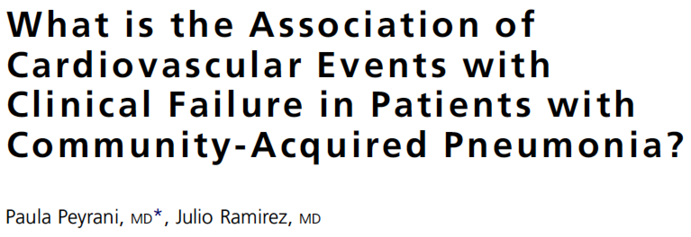
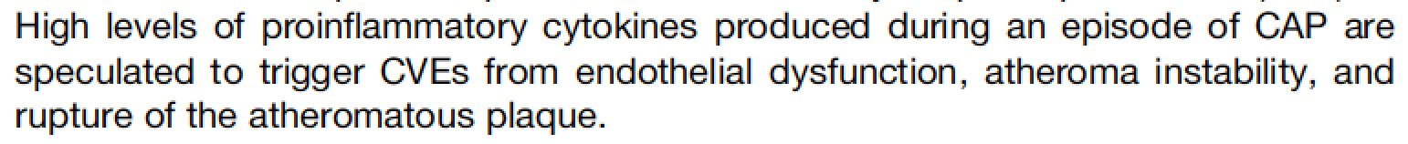
Clinical Outcomes
Early
Clinical
Deterioration
Late
Clinical
Deterioration
Clinical
Failure:
AMI
20%
3
4
Nonresponding
Pneumonia
A
B
5
Severity of Disease
Early
Clinical
Improvement
Late
Clinical
Improvement
1
2

Slide 46
Clinical Outcomes
Clinical Failure:
Males
vs
Females
Early
Clinical
Deterioration
Late
Clinical
Deterioration
3
4
Nonresponding
Pneumonia
A
B
5
Severity of Disease
Early
Clinical
Improvement
Late
Clinical
Improvement
1
2
0 1 2 3 4 5 6 7
Days

Slide 47
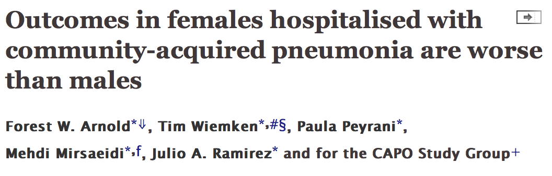
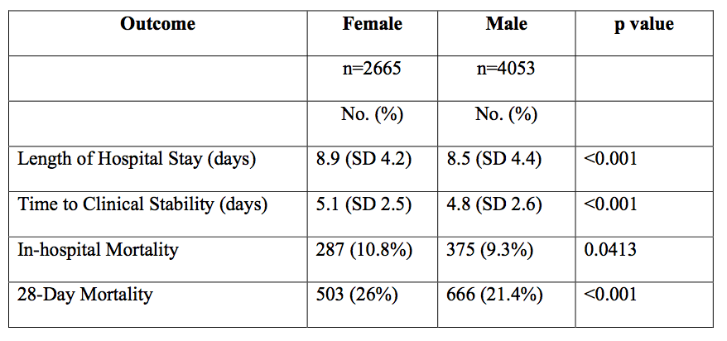
Clinical Outcomes
Clinical Failure:
Males
vs
Females
Early
Clinical
Deterioration
Late
Clinical
Deterioration
3
4
Nonresponding
Pneumonia
A
B
5
Severity of Disease
Early
Clinical
Improvement
Late
Clinical
Improvement
1
2
0 1 2 3 4 5 6 7
Days

Slide 48
Clinical Outcomes
Early
Clinical
Deterioration
Late
Clinical
Deterioration
3
4
Nonresponding
Pneumonia
A
B
5
Severity of Disease
Early
Clinical
Improvement
Late
Clinical
Improvement
1
2
0 1 2 3 4 5 6 7
Days

Slide 49
Clinical Outcomes
Early
Clinical
Deterioration
Late
Clinical
Deterioration
3
4
CAP complicated with empyema
Nonresponding
Pneumonia
A
B
5
Severity of Disease
CAP associated with deterioration of
preexisting medical conditions (COPD, CHF)
CAP due to Mycobacterium tuberculosis
Early
Clinical
Improvement
Late
Clinical
Improvement
1
2
0 1 2 3 4 5 6 7
Days

Slide 50
Clinical Outcomes
Early
Clinical
Deterioration
Late
Clinical
Deterioration
3
4
15%
5%
Nonresponding
Pneumonia
100%
10%
5
A
B
Severity of Disease
45%
25%
Early
Clinical
Improvement
Late
Clinical
Improvement
1
2
0 1 2 3 4 5 6 7
Days

Slide 51
CAP Clinical Outcomes
1. CAP Pathogenesis
2. CAP Early Clinical Outcomes
3. CAP Late Clinical Outcomes

Slide 52
CAP: Clinical Outcomes
Clinical
Deterioration
CAP
A
Clinical
Improvement
1 2 3 4 5 6 7
2 3 4
Days
Weeks

Slide 53
CAP: Clinical Outcomes
Clinical
Deterioration
A
Clinical
Deterioration
CAP
Clinical
Improvement
B
Clinical
Improvement
1 2 3 4 5 6 7
2 3 4
Days
Weeks

Slide 54
CAP: Clinical Outcomes
Clinical
Deterioration
Re-hospitalization
A
Clinical
Deterioration
CAP
Death
Clinical
Improvement
B
Clinical
Improvement
1 2 3 4 5 6 7
2 3 4
Days
Weeks

Slide 55
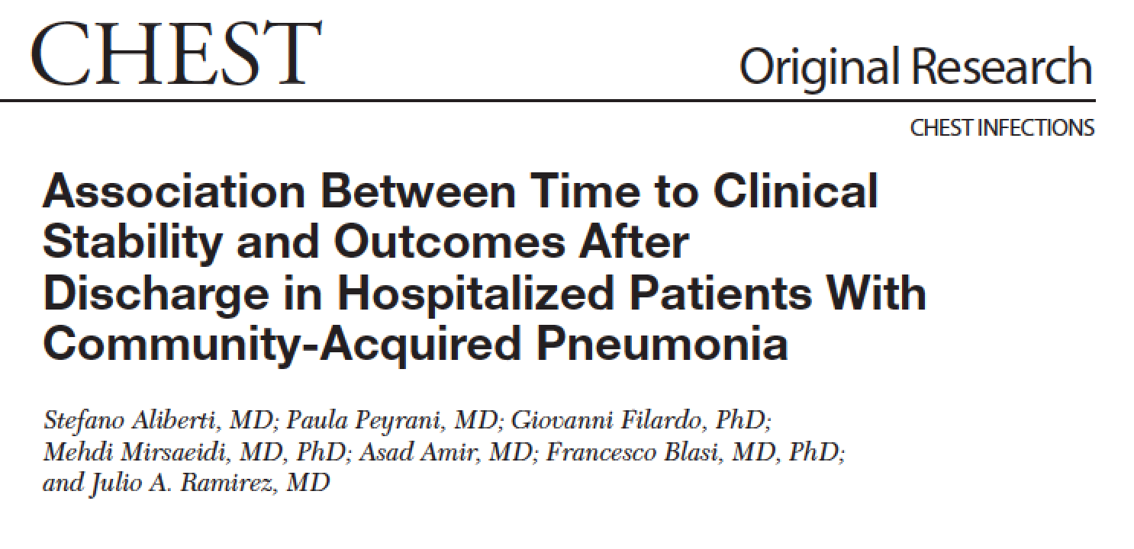
CAP: Clinical Outcomes
Clinical
Deterioration
Re-hospitalization
A
Clinical
Deterioration
CAP
Death
Clinical
Improvement
AMI (+): 31%
B
B
AMI (-): 10%
Clinical
Improvement
Clinical
Improvement
1 2 3 4 5 6 7
2 3 4
2 3 4
Days
Weeks
Weeks

Slide 56
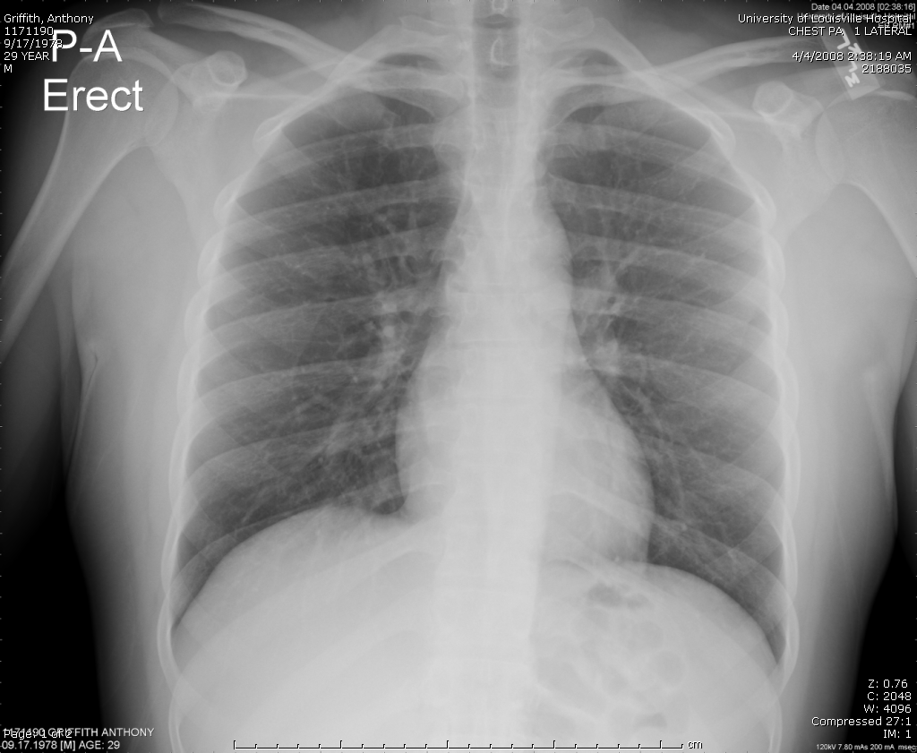
CAP: Clinical Outcomes
Clinical
Deterioration
A
Clinical
Deterioration
CAP
Clinical
Improvement
B
Clinical
Improvement
Clinical Cure: Resolution
of S&S with resolution
of pulmonary infiltrate
1 2 3 4 5 6 7
2 3 4
Days
Weeks

Slide 57
CAP: Clinical Outcomes
Clinical
Deterioration
A
Clinical
Deterioration
CAP (-) 6,347
CAP
Clinical
Improvement
Long Term Survival:
5 years
B
Clinical
Improvement
CAP (+) 624
1 2 3 4 5 6 7
2 3 4
Days
Weeks

Slide 58
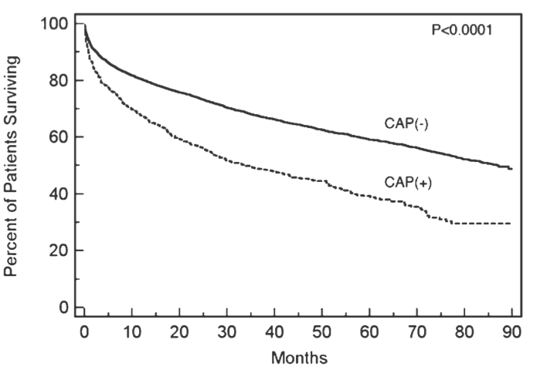
CAP: Clinical Outcomes
Clinical
Deterioration
A
Clinical
Deterioration
CAP
Clinical
Improvement
B
Clinical
Improvement
1 2 3 4 5 6 7
2 3 4
Days
Weeks

Slide 59
CAP: Clinical Outcomes
Clinical
Deterioration
A
Clinical
Deterioration
CAP
CAP (-) 6,347
Clinical
Improvement
B
Clinical
Improvement
CAP (+) 624
1 2 3 4 5 6 7
2 3 4
Days
Weeks

Slide 60
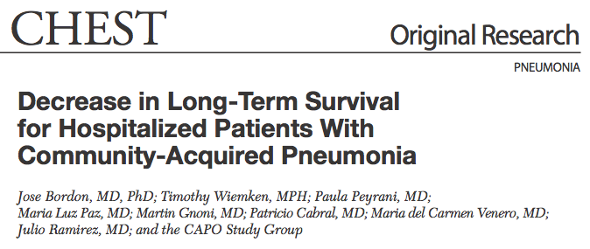
CAP: Clinical Outcomes
Clinical
Deterioration
A
Clinical
Deterioration
CAP
Clinical
Improvement
B
Clinical
Improvement
1 2 3 4 5 6 7
2 3 4
Days
Weeks

Slide 61
CAP: Clinical Outcomes
CAP Mortality:
Days after diagnosis
CAP Mortality:
Weeks after diagnosis
CAP Mortality:
Years after diagnosis
Clinical
Deterioration
A
Clinical
Deterioration
CAP
Clinical
Improvement
Clinical
Deterioration
B
Clinical
Improvement
C
Acute Systemic
Inflammatory Disease
Clinical
Improvement
1 2 3 4 5 6 7
1 2 3 4 5 6 7
2 3 4
2 3 4
1 2 3 4 5
1 2 3 4 5
Days
Days
Weeks
Weeks
Years
Years

Slide 62
CAP: Clinical Outcomes
CAP Mortality:
Days after diagnosis
CAP Mortality:
Weeks after diagnosis
CAP Mortality:
Years after diagnosis
Clinical
Deterioration
Clinical
Deterioration
Chronic Systemic
Inflammatory Disease?
CAP
A
Clinical
Improvement
Clinical
Deterioration
B
Clinical
Improvement
C
Acute Systemic
Inflammatory Disease
Clinical
Improvement
1 2 3 4 5 6 7
1 2 3 4 5 6 7
2 3 4
2 3 4
1 2 3 4 5
1 2 3 4 5
Days
Days
Weeks
Weeks
Years
Years

Slide 63
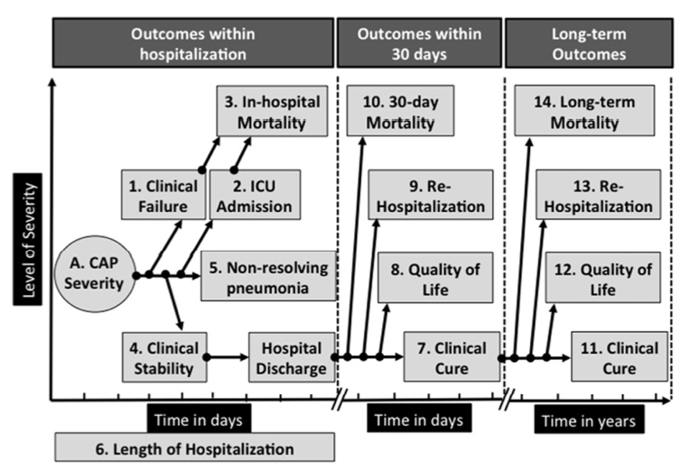

Pneumonia: Clinical Outcomes

Slide 64
Pneumonia: Clinical Outcomes

Slide 65
Pneumonia: Clinical Outcomes

Slide 66
CAP Clinical Outcomes
1. CAP Pathogenesis
2. CAP Early Clinical Outcomes
3. CAP Late Clinical Outcomes

